Slide 1
Living labs as spaces for knowledge production, education and practice innovation
Judith Metz Ph.D. - Professor Urban Youth Work - j.w.metz@hva.nl or 0031-6-21156-79
Amsterdam University of Applied Sciences, School of Social Work and Law

Slide 2
Living lab as perspective
“A living lab is a knowledge infrastructure in which practice, research, policy and education work together. This means that one or more practice institutions collaborate on a structural basis with a university that combines education and research. The goal is to translate issues from practice, education or policy into research questions and to transfer the research outcomes to the practice for validation. The integration of practice, research and education is expected to support the professionalisation of the practice as well as the profession” (Wijnenberg & Nies, 2015, p4).

Slide 3
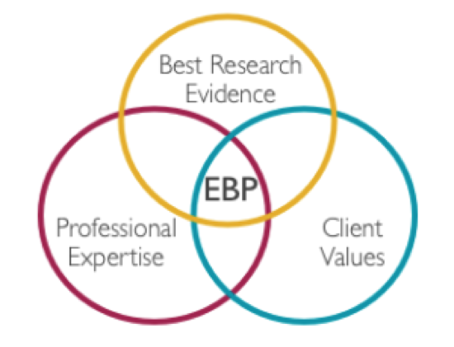




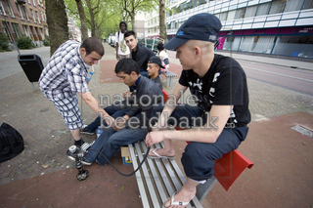
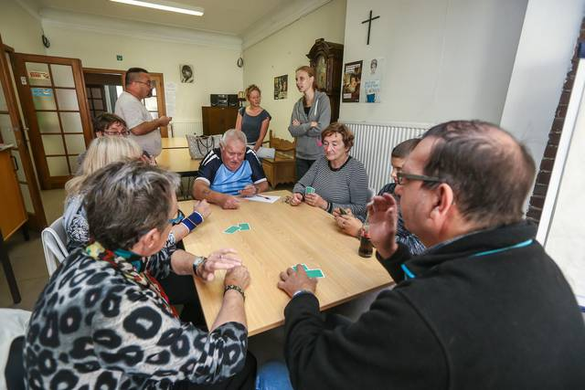
Background:
The need for social work
profession(als) to practice
more effectively

Slide 4
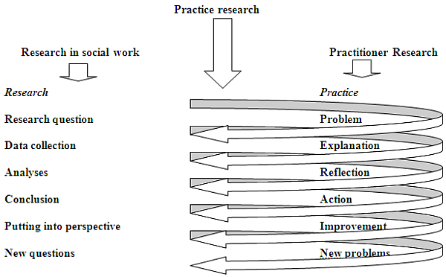


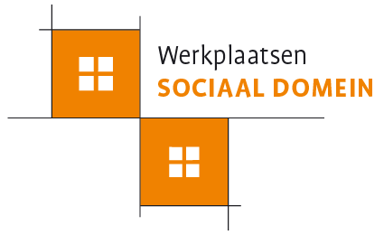
High expectations
Living lab as answer ..
In the Netherlands two approaches:
Research in real life situations
Practitioners, students, educators & researchers learn together
Outcomes are transfered to education & practice

Slide 5
Added value
State of the art ..
Difficulties
Research in real life situations
Means for research
Practitioners, students, educators & researchers learn together
Practitioners, students & educators become familiar with research evidence
Outcomes are transfered to education & practice
Research design that integrates scientific and practice demands
Disturbance by practice dynamics
Time consuming
Role confusion
Realization of all ambitions: knowledge production, education and practice innovation

Slide 6
Living lab in practice:
Model Living Lab
Partnership approach
(Gilovich, 1993; Marsh & Fisher, 2005; Marsh, 2007)
Share knowledge
Partnership in agenda-setting, participation and finance
Students, lecturers, youth workers, teamleaders and researchers participate in their specific role as student, lecturer etc.
Collective ownership results and products
Research method: varies

Slide 7
Conditions for a succesfull living lab:
Project design which has:
  Clear ambitions on research, practice innovation and education
  Adress participants in their specific role
  Research-design that fitts to ambitions on three processes and dynamic practice
  Research instruments that have meaning to practice or education
  Use meetings, focus groups into possibilities of collaborative learning
  Approach for practice innovation
  Approach for education of both students and practitioners
Commitment of all actors (personal and institutional) to project design
Strict projectmanagement

Slide 8
Thank you
Judith Metz Ph.D. - Professor Urban Youth Work - j.w.metz@hva.nl or 0031-6-21156-79
Amsterdam University of Applied Sciences, School of Social Work and Law

